Slide 1

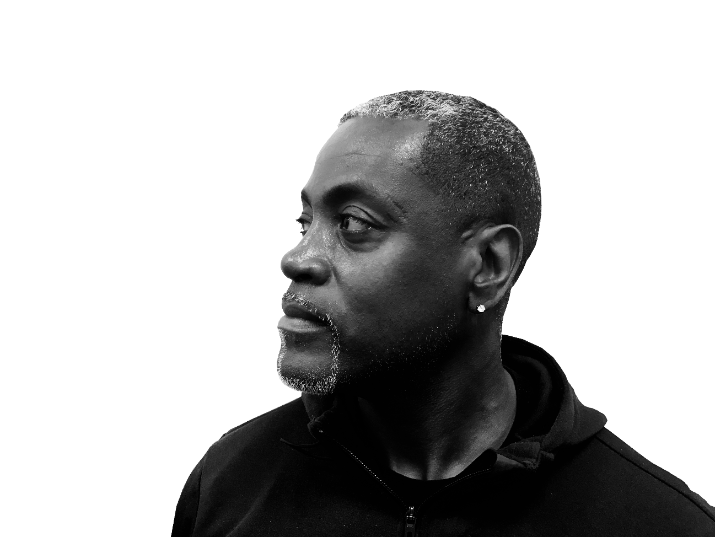
TURNUPHBODIEZ
Home | Classes | Schedule | Program | Rates | About Richard | Contact | TurnupBodies
PERSONAL TRAINING
AND LIFE COACHING

Slide 2
TURNUPHBODIEZ
Home | Classes | Schedule | Program | Rates | About Richard | Contact | TurnupBodies
Classes
Click on a day to view schedule.
Sunday
Monday
Tuesday
Wednesday
Thursday
Friday
Saturday
Schedules
Body Building
Program

Slide 3
TURNUPHBODIEZ
Home | Classes | Schedule | Program | Rates | About Richard | Contact | TurnupBodies
Schedule

Slide 4
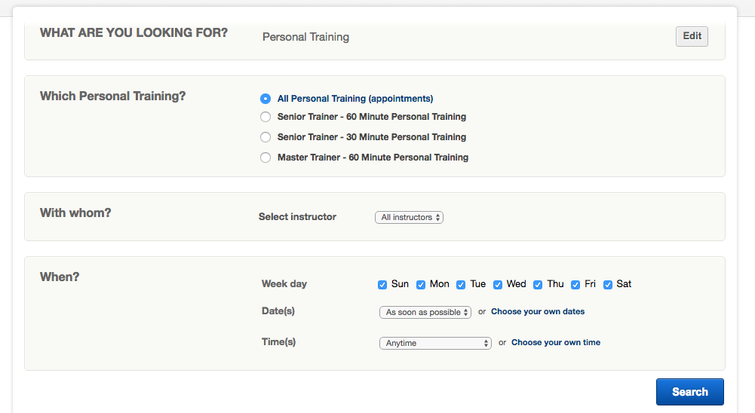
Contact Form – Submit to Email Address: richrdd68@gmail.com

Slide 5
TURNUPHBODIEZ
Home | Classes | Schedule | Program | Rates | About Richard | Contact | TurnupBodies
Program
BEGIN YOUR JOURNEY TO A BETTER PHYSIQUE TODAY!

Slide 6
Training Program
How It Works
Welcome to TURNUPHBODIEZ
TURNUPBODIEZ is a privately owned, personal training facility by appointment, training facility. We offer state of the art equipment and professional, certified personal trainers to assist you with your wellness goals.
Every training program is customized to address your individual fitness profile, allowing you to increase your level of fitness and reach your objectives as defined in partnership with your trainer. Our goal is to have you look and feel your best while empowering you to do more and be more.
We work with clients globally, so no matter where you live, we can help you achieve your fitness goals! We work with clients of all different fitness levels, from those who are complete beginners and have never worked out in their lives, all the way to those who are advanced. We work with all ages, both male and female, and people with all different fitness goals. We have clients who have over 100 pounds to lose, and are here because they need to change their habits in order to save their lives, all the way to clients who are in good shape and looking to be in Better shape, or compete in a fitness competition. We make programs for clients who are training at the gym, as well as clients who are going to be working out at home.
One important thing to know is that you are working directly with Richard and his trained professional trainers. We do not have automated systems. Every single program is made for you directly by Richard or his trainers. They are the ones personally reviewing the information that you send in, and personally sitting there developing the program that will help you get to your goals. This enables us to work with each unique client, cater their workouts and nutrition according to their needs. If you have a question and use the LIVE chat function on the site, you will be asking a question directly to Richard or trainers and you’ll get a response from one of them. As often as possible, we keep the LIVE feature open on our computers in case you have a question while browsing the site!

Slide 7
One important thing to know is that you are working directly with Richard and his trained professional trainers. We do not have automated systems. Every single program is made for you directly by Richard or his trainers. They are the ones personally reviewing the information that you send in, and personally sitting there developing the program that will help you get to your goals. This enables us to work with each unique client, cater their workouts and nutrition according to their needs. If you have a question and use the LIVE chat function on the site, you will be asking a question directly to Richard or trainers and you’ll get a response from one of them. As often as possible, we keep the LIVE feature open on our computers in case you have a question while browsing the site!
The FIRST step once you are ready to get started with your transformation, is to choose the program that is right for you. All program options are HERE. You can also check out the Turnuphbodiez fit home page, if you scroll down you will see a listing for each program, and there is a link that you can click to hear a description, or read about it. If you still have further questions about what program is right for you. You can try the LIVE chat feature, and we will respond right away if we are available. Or you could also write to Richard at rdilwood@yahoo.com.
Once you have chosen your program, you register for in the Store. www. Turnuphbodiez-personal-training-and-life-coaching.com
When you have registered for the program of your choice. You will receive a questionnaire to your email. This questionnaire will gather information as far as your current stats such as height, weight, age, body fat (For your assistance there’s a body fat calculator to help you out on home page.) We also gather information as far as your current fitness level, where you plan to do your workouts (home or gym), if at home, what equipment you have available. We also find out if you have any injuries we need to work around, medical issues that we need to be aware of, dietary issues that we need to be aware of etc. We will ask for your current before pictures. Nobody likes doing before pictures, but they truly are a critical element! Since this is all done Online, the only way we get to “see” you, and also see the progress that you make over time, is via pictures. Taking pictures also is a great way for you to be 100% open about your starting point, if you want to change, then these pictures are information, they are your starting point, and also great motivation. Seeing where you are now, and being honest about that side of things, can be a great motivator to stay on track with making healthy choices for yourself on a consistent basis, as you strive to make that reflection of yourself be something different, healthier and that you feel really great about!

Slide 8
It’s important to know that every story that is on our site is a person who has gone through transformation and then given us permission to share their images and stories in order to pay it forward and inspire others to make positive change. We don’t force anyone or pay anyone to share their stories. The only time that we share client images is if they have completed transformation and have given permission to share their story. We never share anyone’s pictures without their consent. So if this is something you are worried about, your mind can rest at ease, because it’s simply not how we operate.
It’s best to complete your questionnaire and return it to us as quickly as possible. We put together programs in the order that we receive back questionnaires. It typically takes between 2-5 days to put your program together for you. If there is incomplete information or questions not answered, then we will reach out to find out more information from you as we put together your program. At the top of the questionnaire that you receive, will be the downloadable Turn-up hbodiez Lifestyle Book. The book is not your program; it is supplemental information about healthy living. We do also have a YouTube channel with all the exercise demonstrations on it www.Youtube.com/Turnuphbodiez lifestyle.
Your completed program will come via email from either Richard or Trainers. It will include your nutrition program (we tell you what to eat, when to eat it and how much of it to eat and also give you a variety of options to mix and match your foods so you don’t get bored). We do not believe in fad diets or quick fix diets or cutting out food groups. We do not believe in starving clients. We believe in teaching you a balanced way of eating, teaching you how to read labels, measure portions, learn the staples of nutrition that will not only get your body to a place that is healthy and leaner, but if you embrace the teachings as a lifestyle and remain consistent with the habits that you learn on this program, you can sustain your losses for the rest of your life. Your program will also include your workouts, based on fitness level and where you will be training. It will include how much cardio to do through the course of your program. Cardio volumes will vary per person depending on what your starting body fat and goals are.
Once you have received your program, you can take your time reviewing things. Your start date is up to you. We just ask that you let us know when you are starting. We do not have a ticking clock once you purchase your program, and we don’t just stop communicating with clients once their 12 or 16 weeks (or longer for some of the programs such as PLUS or Get Big Get Ripped). Once you are a part of the Turn-up- hbodiez lifestyle. Family, you are always a part of the family!

Slide 9
You have unlimited access to online support from Richard and professional trainers during your transformation time. We ask that online clients check in at least once weekly with their updates, but we are also available for questions at any time. So if something comes up, you have an issue you need guidance on, we are here to answer and help you through it. Our ultimate objective is for you to be successful, so we do our best to help clients through whatever obstacles pop up along the way!
This transformation process is something that can change your life. The visual results that take place in the course of body transformation is wonderful, but it’s the changes that we see happen on the inside that are the most impacting. We see health improved, we see confidence and energy levels increase, we see people really start believing in themselves which trickles over into every other aspect of their lives!!
I’m truly Blessed to have the ability to share a passion for health with others, along with being able to do what I truly love and that’s training. The passion allows me to help other see the true meaning of what it means to honor God with a healthy mind and body. If you are ready for your lifestyle change, we are ready to assist you through this magnificent journey of healthy living!!
PERSONAL TRAINING
ONLINE TRAINING
Our Personal Trainers are skilled professionals with extensive experience and are nationally certified by the American College of Sports Medicine, the International Fitness Professionals Association, and/or American Council on Exercise. They possess the knowledge and skills needed to design and implement safe and effective workout programs for both general and special populations. Your Personal Trainer will work hard to help you achieve your goals while keeping you motivated and most importantly, accountable. They are invested in seeing you succeed!
KMO offers affordable,quality training for highly motivated individulas that are unwilling or unable to work with me in the studio. I equip you with the knowledge and tools you need to succeed in your wellness goals. Training is customized to the individual and covers nutrition,supplements,workout programs,on-line support and that accountability that will help you achieve your goals and reach your personal best. Email for more information at info@moffettpersonaltraining.com
NUTRITIONAL GUIDANCE
COMPETITION TRAINING
No amount of exercise will reshape your body without appropriate nutrition. If you want to lose weight easily, never feel hungry, have increased energy, and keep the fat off forever, there is only one surefire way, and MPT trainers know it well. We know that maintaining a well-rounded diet can be challenging. Poor eating habits, busy lifestyles and conflicting information about food make it even more challenging. We offer straightforward simple solutions that will have you and your family headed in the right direction.
As a top 3 Nationally ranked Figure and Bikini competitor, I know what it takes to succeed in this sport. Competition training encompasses every detail that goes into transitioning from gym to stage-including nutrition,workouts and image prep. If you are serious about being the best that you can be and competing at your personal best you owe it to yourself to invest in a coach that walks the walk and knows what it takes to be a winner. Email me today for more information at info@moffettpersonaltraining.com

Slide 10
TURNUPHBODIEZ
Home | Classes | Schedule | Program | Rates | About Richard | Contact | TurnupBodies
Rates

Slide 11
THE MOST AFFORDABLE AND EXPERIENCED TRAINERS IN Atlanta
Please call 404-964-9685 to schedule an appointment for your free consultation
Number of sessions | Price per session | Total Price | Savings | Average length of sessions
1 | $80 | $80 | - | -
4 | $70 | $280 | $55 | 1-2 weeks
12 | $65 | $780 | $195 | 4-6 weeks
24 | $60 | $1,440 | $480 | 2-3 months
48 | $55 | $2,640 | $1,215 | 4-6 months
CURRENT SPECIALS
$49 PER SESSION + TAX
Ask
me
about my discounts
for “non-prime” hours!
5 TRAINING SESSIONS FOR ONLY $250
Buddy Training Discounts
Senior Discounts

Slide 12
Skype Personal Training/Consulting (Pricing vary)
Corporate or Home Training
Each session runs an hour in length. There is no membership fee, or any other fees. Unlike other gyms, you can pay as you go at FLEX—there is no big sign-up to get our special. Your training with us also includes a diet and cardio program—everything will be laid out for you. Generally our clients book 2 to 3 sessions a week to obtain their fitness goals. If you are interested, we can set you up with a free 30 minute consultation!
Contact Us Now For a Free Consultation

Slide 13


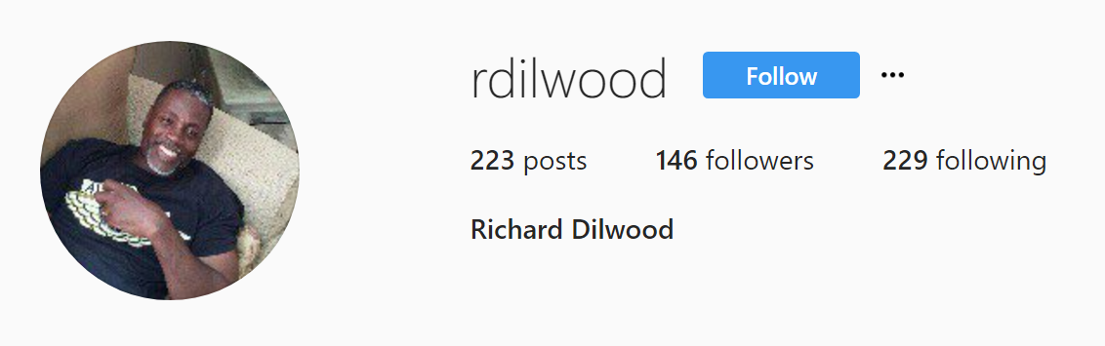
TURNUPHBODIEZ
Home | Classes | Schedule | Program | Rates | About Richard | Contact | TurnupBodies
About Richard

Slide 14
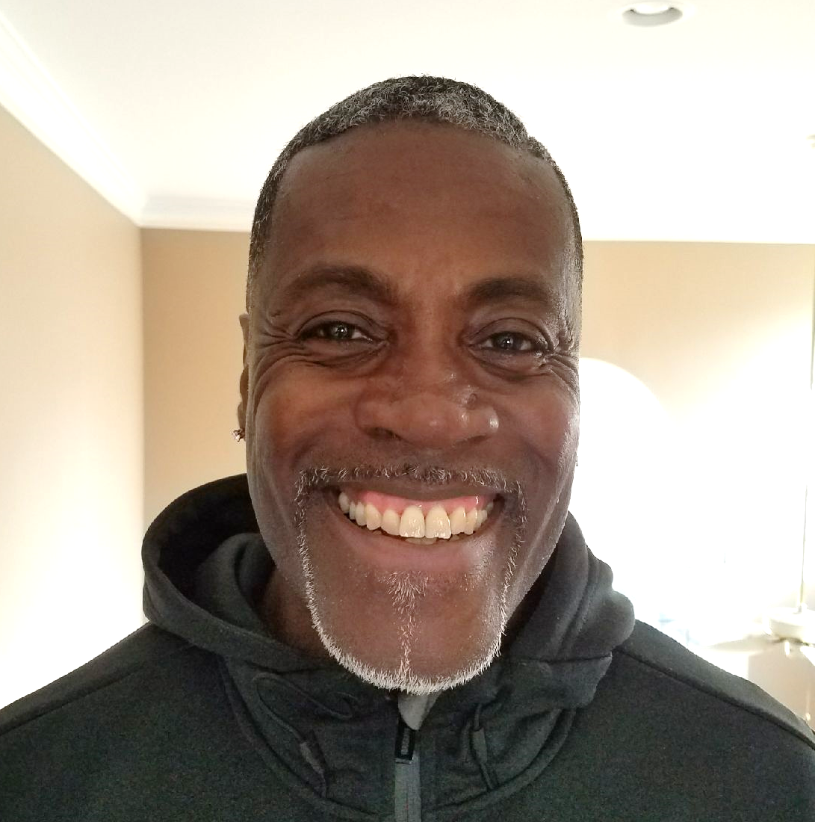
Richard Dillwood has been working as a professional personal fitness trainer in Atlanta since 1992. He is the most effective and inspiring personal trainer in Atlanta. He is also the most knowledgeable and experienced 1 on 1 Personal Trainer in Atlanta for Weight Loss and all levels of fitness from beginner to advanced.
Richard specializes in both online training/coaching, 1X1 personal training, Nutritional guidance, and completion training to Metro Atlanta’s elite. Richard has worked with CEO's, athletes & celebrities from across the country and can help you get the results you want - regardless of your fitness goals and experience level. Regardless if you are in Atlanta or across the country, it's time to put yourself in the hands of a true fitness professional.
BEGIN YOUR JOURNEY TO A BETTER PHYSIQUE TODAY!

Slide 15
Become a client
New Client Intake Questionnaire

Slide 16
TURNUPHBODIEZ
Home | Classes | Schedule | Program | Rates | About Richard | Contact | TurnupBodies
Contact

Slide 17
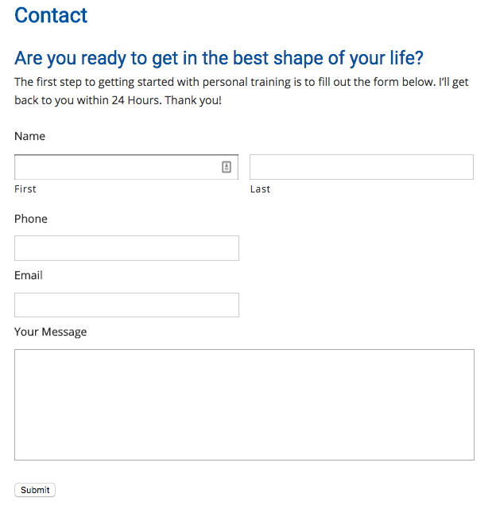
Richard Dillwood
(404) 964-9685

Slide 18
TURNUPHBODIEZ
Home | Classes | Schedule | Program | Rates | About Richard | Contact | TurnupBodies
TurnupBodies
START YOUR TURNUPBODIES TRANSFORMATION!
Please take a minute to read my testimonials
and then contact me to get started!

Slide 19
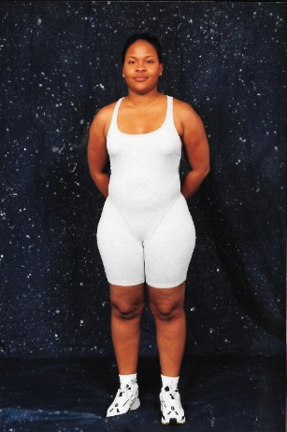
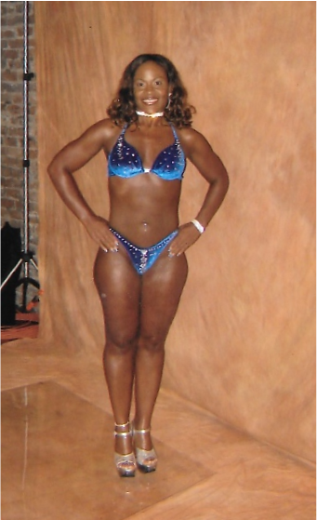
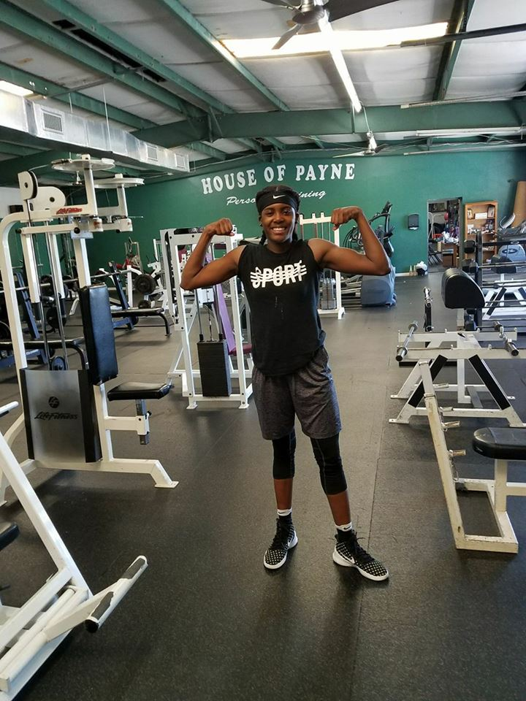
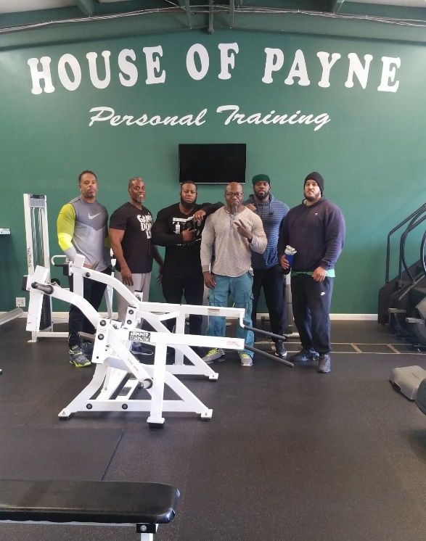
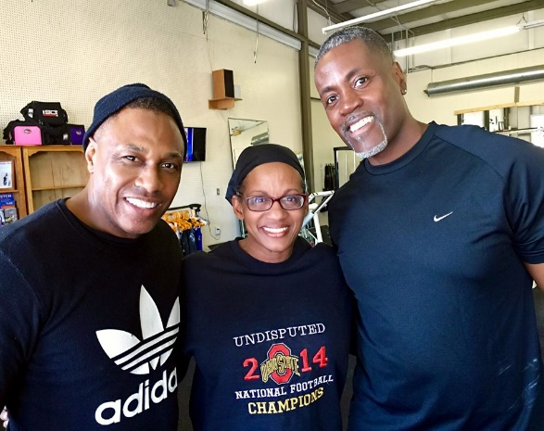
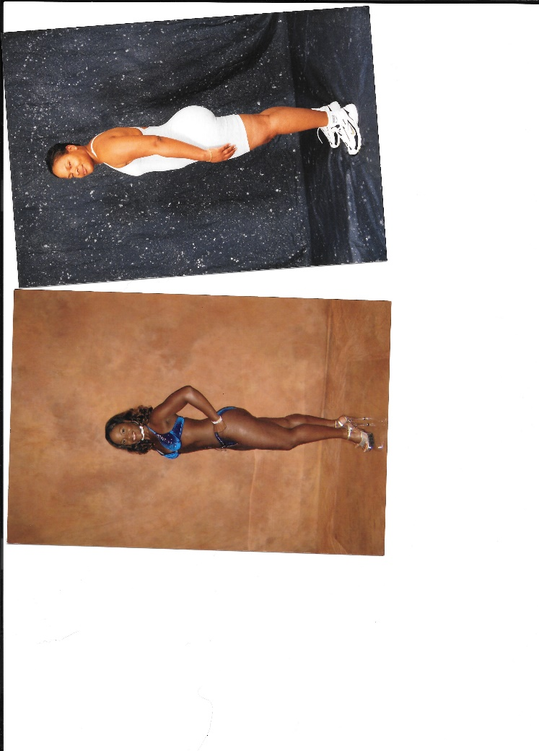

TRANSFORMATION 4
TRANSFORMATION 1
TRANSFORMATION 2
TRANSFORMATION 3
TRANSFORMATION 5

